Slide 2
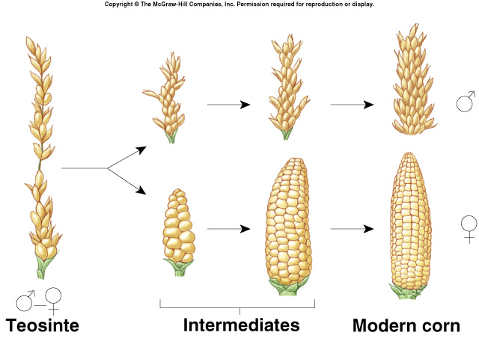
How have humans been altering the gene pool of crops?
Artificial Selection: Humans pick individuals with desired traits and cross them to create the next generation.
We’ve been doing it for 30,000 years!!

Slide 3
How have humans been altering the gene pool of crops?

Slide 4
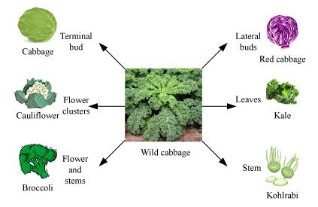
This has allowed us to create new varieties of foods. Almost all things we eat are not found in the wild.

Slide 5
And dogs…

Slide 6
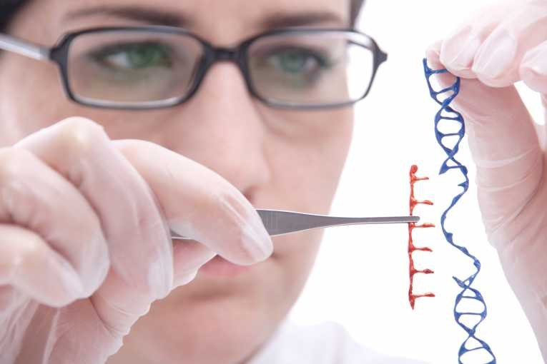
How have humans been altering the gene pool of crops?
Genetic Engineering: Scientists select the GENES they want and insert them into the genome of an organism.
Not to scale. Duh.

Slide 7
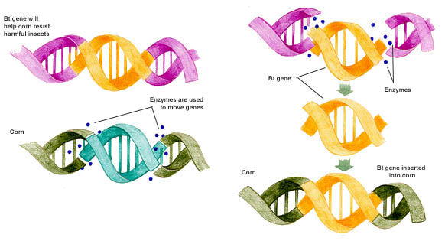
Example: Insect Resistant Corn

Slide 8
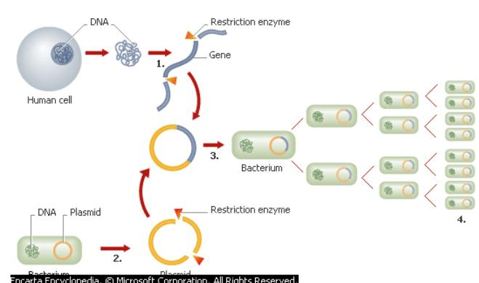
Example: Insulin Producing Bacteria
Combo of Human AND Bacteria DNA
Bacteria

Slide 9
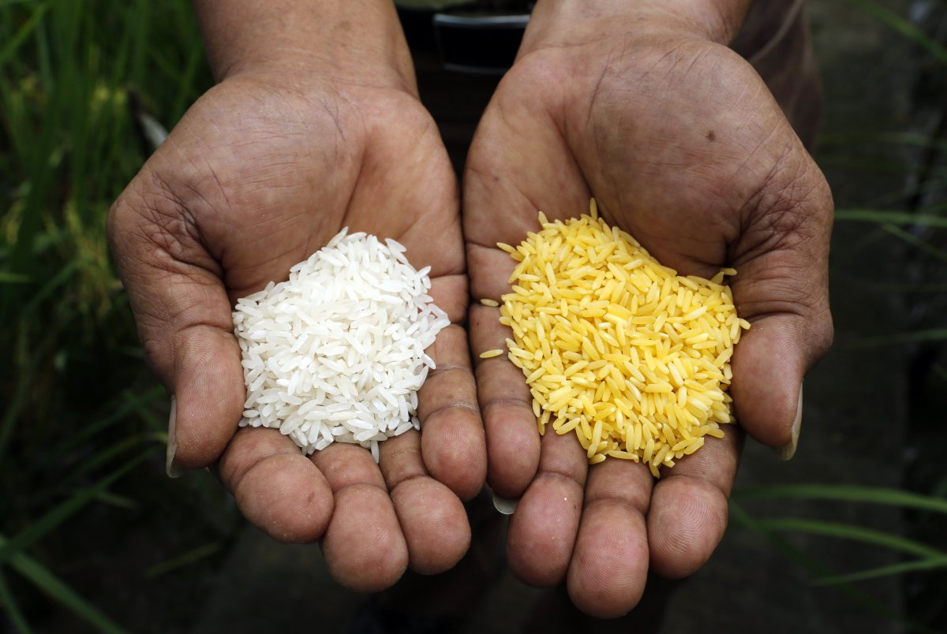
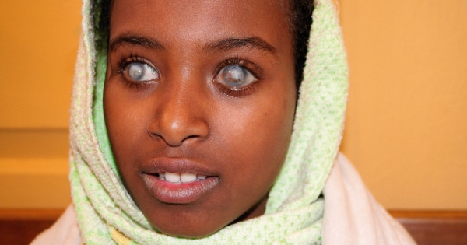
Example: Golden Rice
Golden Rice has been genetically modified to produce beta-carotene in the endosperm of grain, has been proposed to control vitamin A deficiency, especially among the poor in developing countries.
http://www.world-grain.com/articles/news_home/World_Grain_News/2016/08/Golden_Rice_still_struggling_f.aspx?ID=%7BC92F4CE9-6F84-44BC-947F-E98D022BE8FD%7D&cck=1

Slide 10
Write down pros and cons of GMOs while watching the videos. (Pg. 2)
Video on GM papaya: https://www.youtube.com/watch?v=2G-yUuiqIZ0
Bill Nye Intro to GMOs: https://www.youtube.com/watch?v=8z_CqyB1dQo
Are the concerns about GMO valid?
Health Triage: https://www.youtube.com/watch?v=gKO9s0zLthU
https://www.youtube.com/watch?v=b8qvskYvnH8
Not all GMOs are created equal
https://www.youtube.com/watch?v=fIgqXCRkMkA

Slide 11
Crops that have been genetically modified:
Alfalfa
Canola
Corn (field and sweet)
Cotton
Papaya
Potatoes
Soybeans
Squash
Sugar Beets
Granny Smith Apple

Slide 12
What GM foods are out there?
Why are they Genetically Modified?

Slide 13
Growing a GMO Crop
Growing a non-GMO Crop
Desired traits can be fairly quickly identified. (<10 years)
Desired traits can be identified. It may take a significant amount of time (decades) to find.
Desired traits can be identified and perpetuated.
Plants can become genetically resistant to disease or pests.
Disease and pests are controlled with chemicals or other cultivation practices.
Life cycle and growth of plant is equivalent.
Nutrition of plant is equal.
Safety
Scientists can find a single specific trait and insert it into the DNA.
Desired traits cannot be perpetuated individually.

Slide 14
GMO Regulation Process (Laws & Policies)
It takes many years to be developed, tested, and finally approved for commercial release.
Prior to the release of a new GM crop it is tested and monitored by:
FDA - Food and Drug Administration
USDA - United States Department of Agriculture
EPA - Environmental Protection Agency

Slide 15
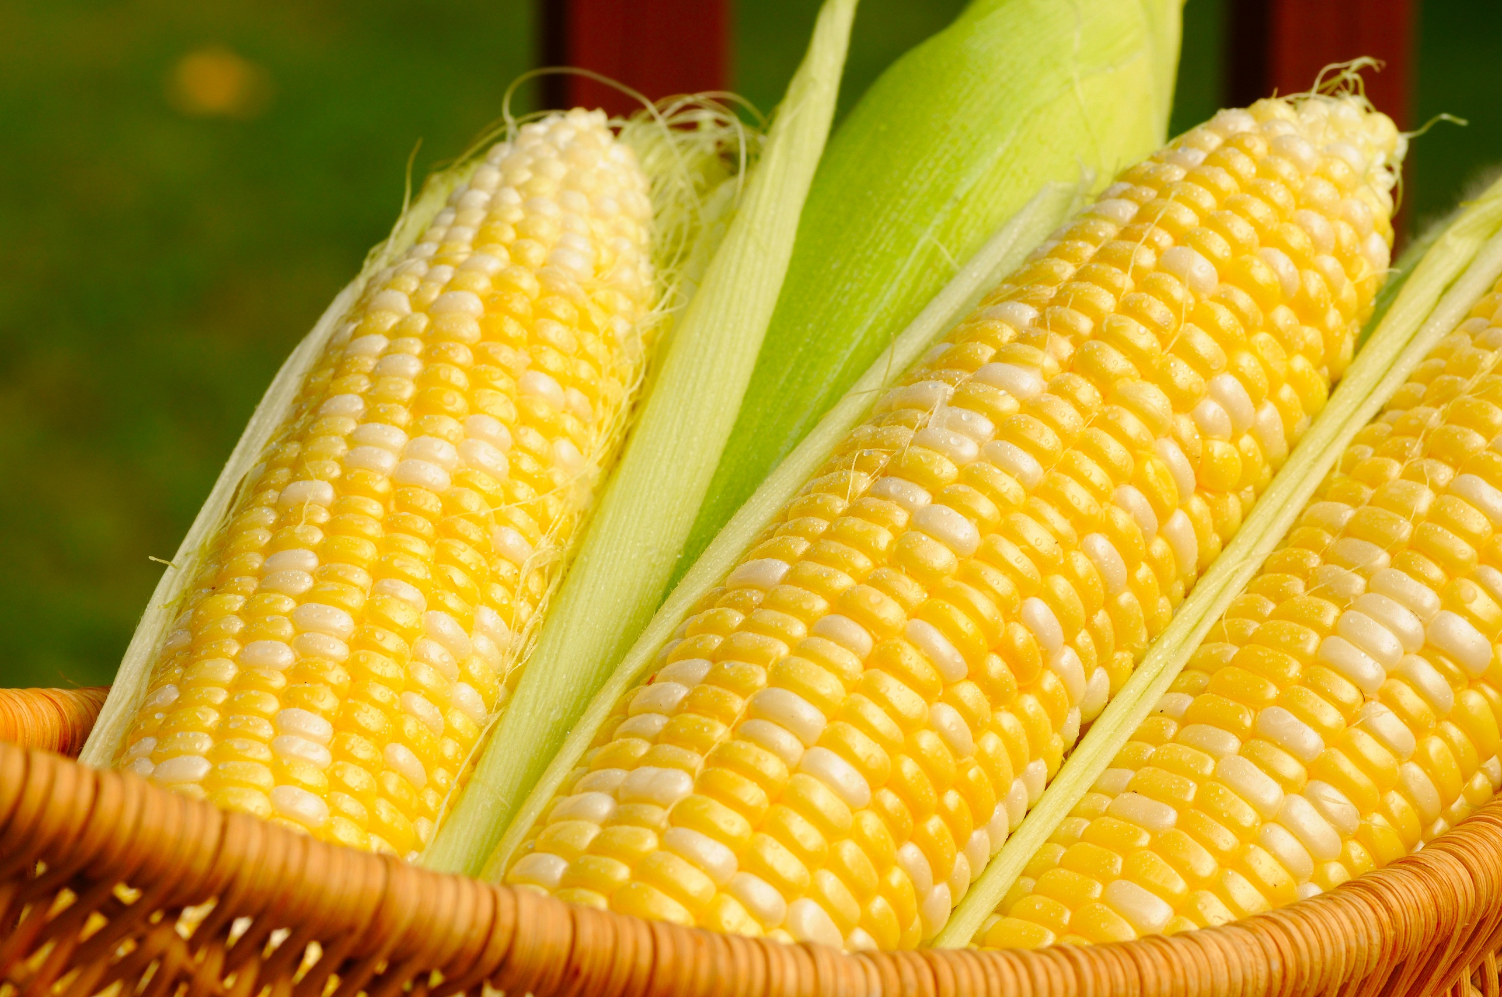
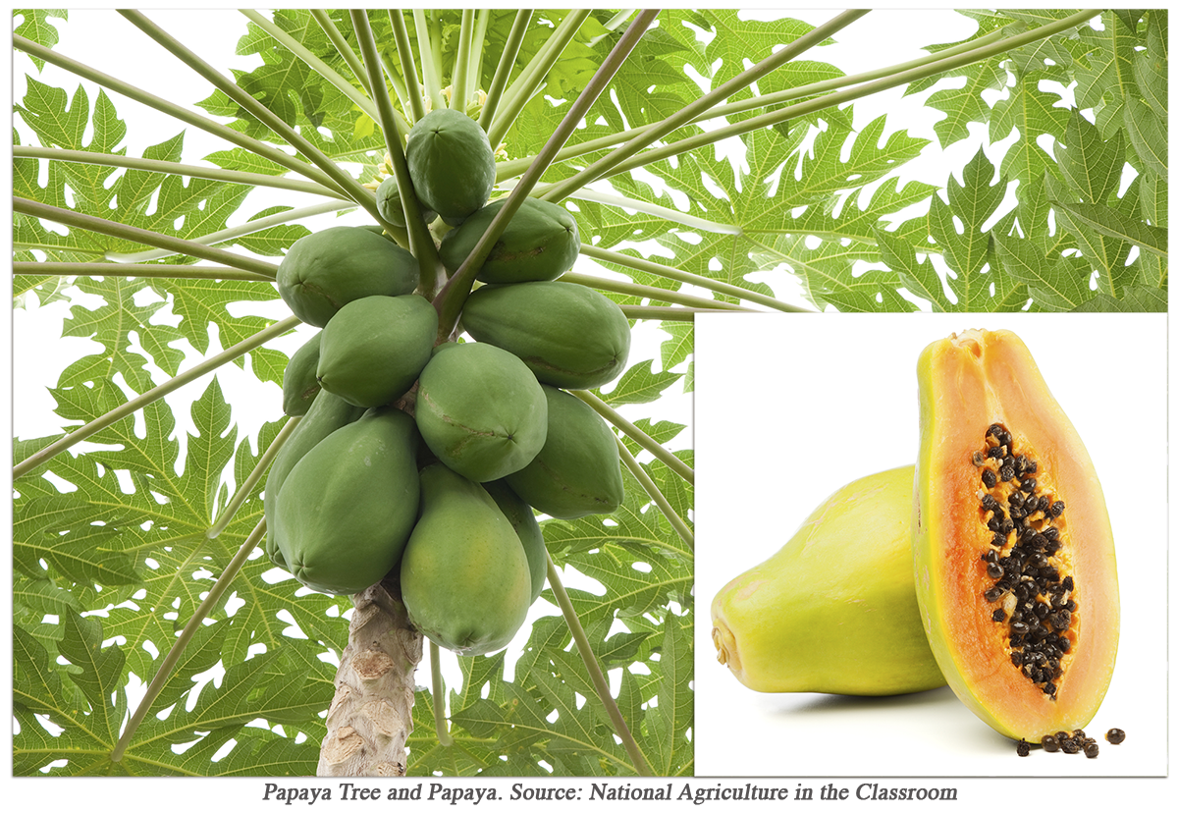
Not all GMOs are created equally
https://www.youtube.com/watch?v=fIgqXCRkMkA
Corn vs. Papaya:
Different genes were inserted into these two plants making their new traits (& potential risk) very different.

Slide 16
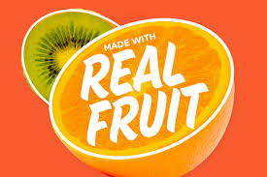
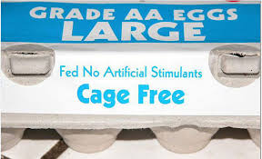
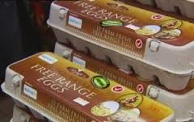
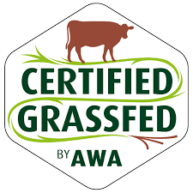
What do these labels mean to you?

Slide 17
Have you seen these labels?
Are there any food labels that could be misleading or meaningless?

Slide 18
Make 2 piles of cards
True non-GMO
Food Labels
Misleading non-GMO
Food Labels
“Imposters”

Slide 19
Alfalfa
Canola
Corn (field and sweet)
Cotton
Papaya
Potatoes
Soybeans
Squash
Sugar Beets
Granny Smith Apple

Slide 21
Source of material for this lesson:
http://www.agclassroom.org/teacher/matrix/lessonplan.cfm?lpid=86

